Slide 1

Logistic Regression
Summer Internship- 2026
Name: Kanak
Supervisor: Prof. Millie Pant
Mentor: Ms. Riya Applied Mathematics & Scientific Computing
Indian Institute of Technology Roorkee

Slide 2

Agenda
Classification & Binary Classification
Logistic Regression
1
2
Odds Ratio & Logit
Sigmoid Function
3
4
Log Loss Function
Applications
5
6
1

Slide 3
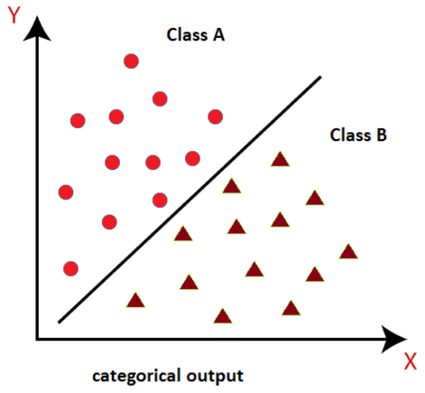
Classification & Binary Classification
Classification
A supervised learning task that predicts a discrete class label for each input, rather than a continuous number
Examples: binary (spam or not spam)
Binary Classification
Exactly two possible outcomes, usually coded as 0 (negative) and 1 (positive)
A model estimates the probability p of the positive class; a threshold (commonly 0.5) converts p into a class label
Common examples: disease diagnosis, fraud detection, email spam filtering, customer segmentation.
Two classes separated by a decision boundary
2

Slide 4
Logistic Regression & Odds Ratio
Logistic Regression
Logistic Regression is a supervised learning algorithm primarily used for classification tasks. Despite its name, it focuses on predicting the probability that a data point belongs to a specific category.
Odds & Odds Ratio
Odds = p / (1–p): The ratio of success to failure. It can range from 0 to infinity.
Logit (log-odds) = ln(p / (1–p)): Log odds is simply the natural logarithm of the odds.
Odds ratio =The Odds Ratio compares the odds of an event happening under two different conditions
3

Slide 5
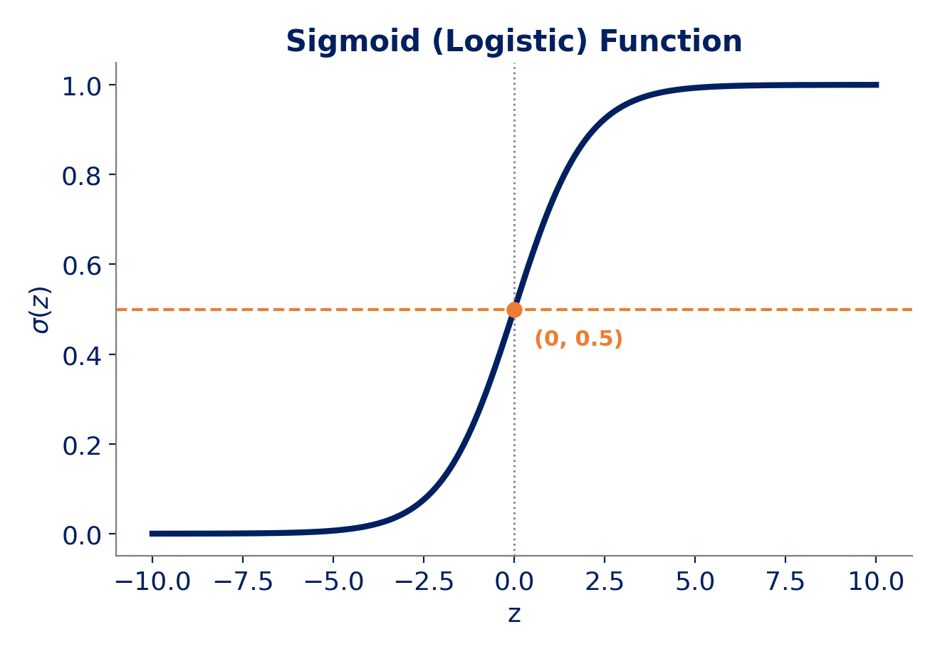
The Sigmoid Function
The S-Shaped Activation
At the heart of the model is the Sigmoid (Logistic) function. It transforms the linear combination of inputs into a valid probability.
p=1/(1+e^-z)
This ensures that no matter the input magnitude, the resulting prediction remains strictly bounded within the (0, 1) interval.
How It Is Derived (from the Logit)
Start from the logit equation: ln( p / (1-p) ) = z
Exponentiate both sides: p / (1-p) = e^{z}
Solve for p: p = e^{z}(1-p) = e^{z} - e^{z}p
Collect p terms: p(1 + e^{z}) = e^{z}
p = e^{z} / (1 + e^{z})
Divide numerator & denominator by e^{z} : p = 1 / (1 + e^{-z}) = σ(z)
4

Slide 6

The Log Loss Function
Definition:-Log Loss (Logarithmic Loss)(Binary Cross-Entropy Loss) is the standard evaluation metric used to measure the performance of a classification model (such as Logistic Regression)that outputs a probability value between 0 and 1.
Deriving Log Loss
Probability for a single point (Bernoulli PMF)-For a binary outcome(y=0 or 1), the probability of a single observation is written as:
L = p^{y}(1-p)^{1-y}
For m independent samples, the total likelihood is the product: L = Π pi^yi (1-pi)^(1-yi)
Taking the log turns the product into a sum (log-likelihood): ln L= Σ [yi ln(pi) + (1-yi) ln(1-pi)]
Maximizing log-likelihood is the same as minimizing its negative, averaged over m samples — this defines the cost function
$$j\left(θ\right)=−(\frac{1}{m})\sum{[yi∗ln\left(pi\right)+\left(1−yi\right)∗ln(1−pi)]}$$
5.
Where y = actual value
p_{i} = predicted value
5

Slide 7
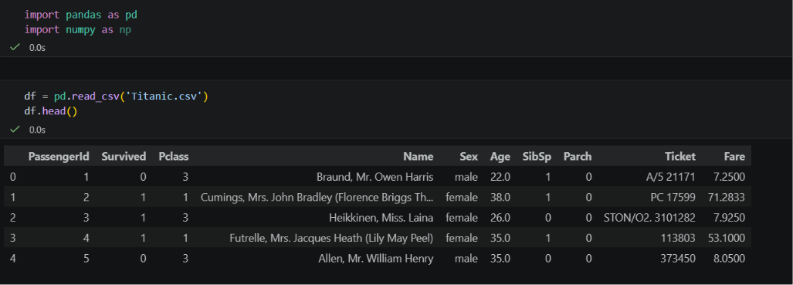
Logistic Regression Application: Titanic Case Study
6

Slide 8
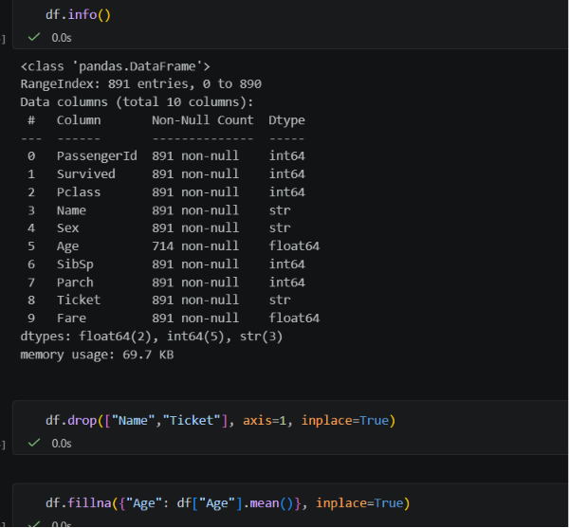
Logistic Regression Application: Titanic Case Study
7

Slide 9
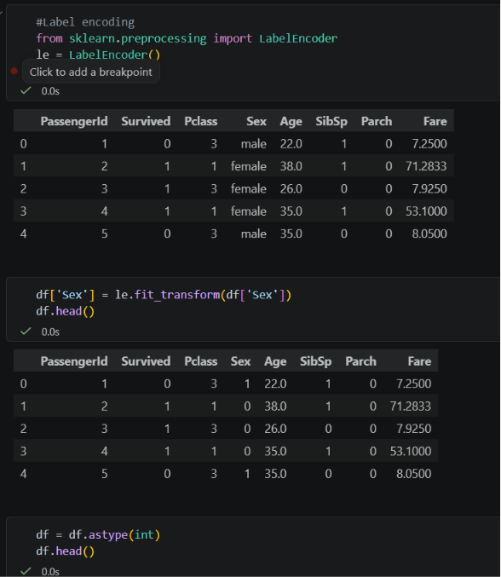
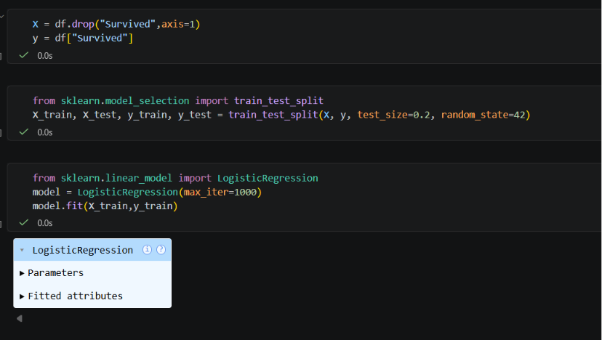
Logistic Regression Application: Titanic Case Study
8

Slide 10
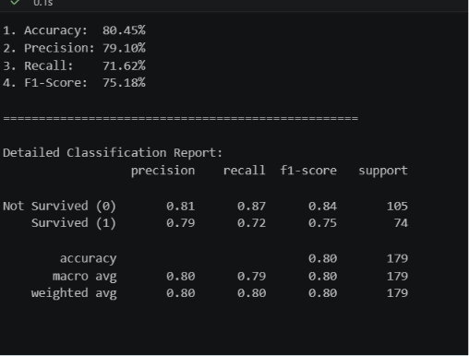
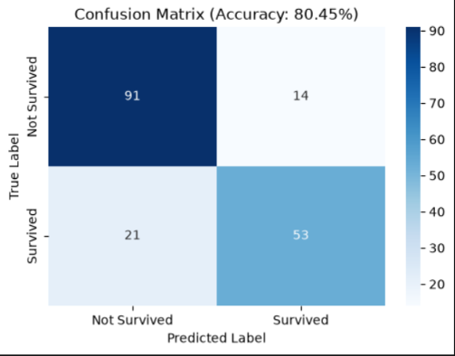
Logistic Regression Application: Titanic Case Study
9

Slide 11
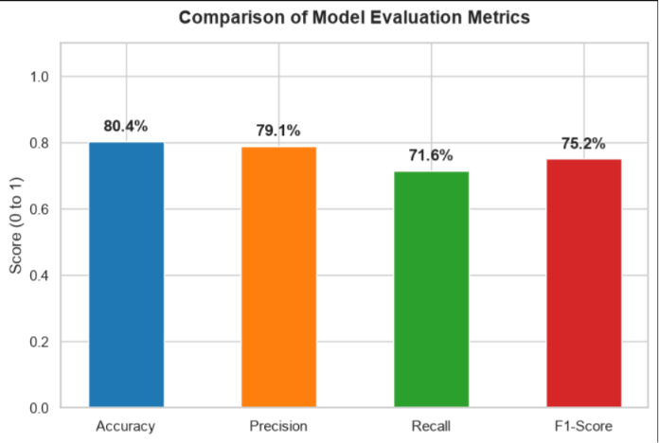
Logistic Regression Application: Titanic Case Study
10

Slide 12
Applications of Logistic Regression
Healthcare
Predicting disease risk, e.g. diabetes or cancer diagnosis from patient data
Finance
Credit scoring, loan default prediction and fraud detection
H
F
Marketing
Predicting customer churn and ad click-through / conversion
Email & Security
Spam vs. legitimate email and intrusion detection
M
S
Political Science
Modeling voter turnout and election outcomes
Human Resources
Predicting employee attrition and hiring outcomes
V
P
11

Slide 13
References
Hosmer, D. W., Lemeshow, S., & Sturdivant, R. X. (2013). Applied Logistic Regression (3rd ed.). Wiley.
Bishop, C. M. (2006). Pattern Recognition and Machine Learning. Springer.
James, G., Witten, D., Hastie, T., & Tibshirani, R. (2021). An Introduction to Statistical Learning (2nd ed.). Springer.
Ng, A. (Stanford CS229). Lecture Notes on Logistic Regression and Generalized Linear Models.
scikit-learn documentation: Logistic Regression, https://scikit-learn.org/stable/modules/linear_model.html#logistic-regression
Kaggle Datasets — https://www.kaggle.com/datasets
12

